Slide 1
Example Auto PPT
Andrew Chen

Slide 2
Measurement Conditions
Voltage Range: 0.9
Voltage Step Size: 0.01
Voltage Read Count: 5
Voltage Delay Time: 20
Voltage Measurement Time: 6

Slide 3
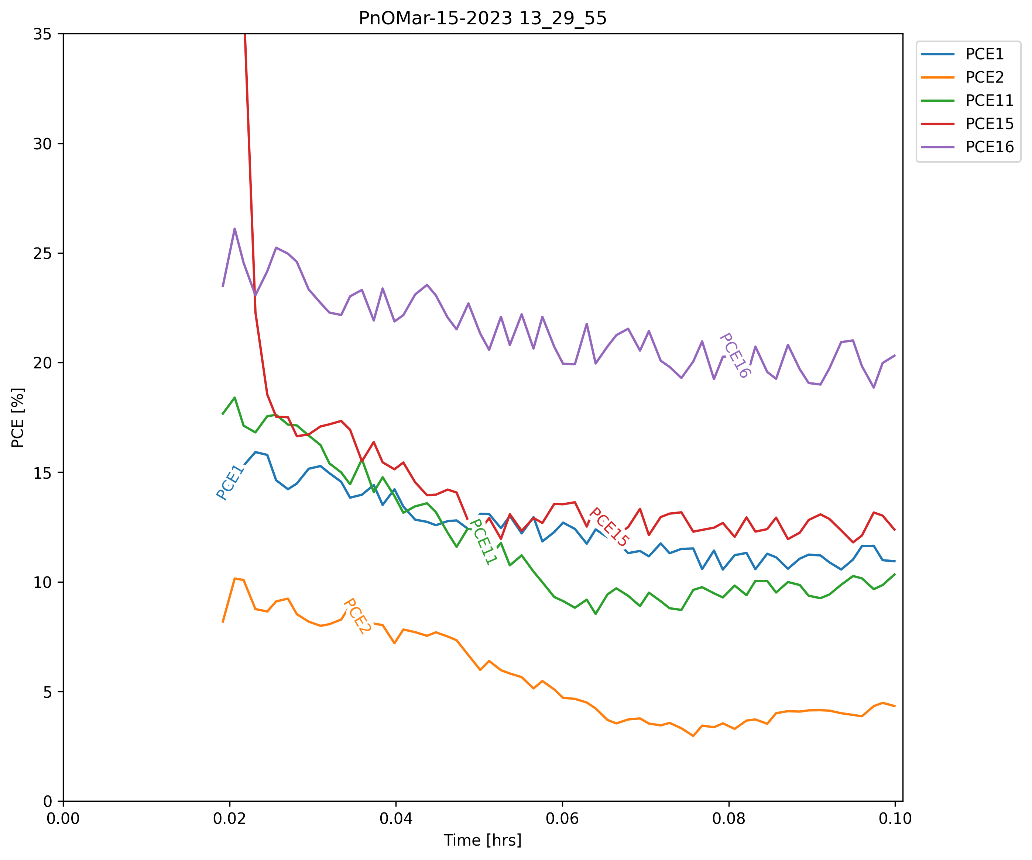
Averaged PNO Traces (ALL)

Slide 4
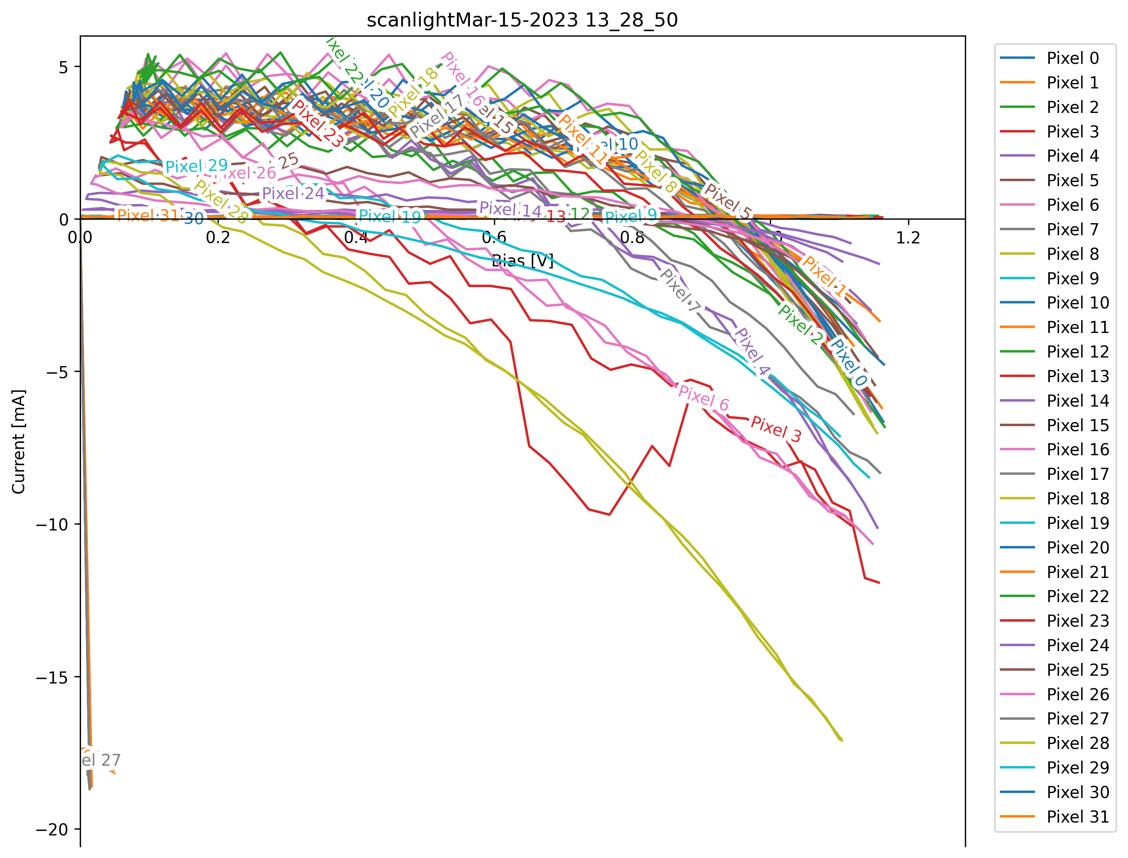
Dark JV Before | Dark JV After

Slide 5
Light JV Before | Light JV After

